Slide 1
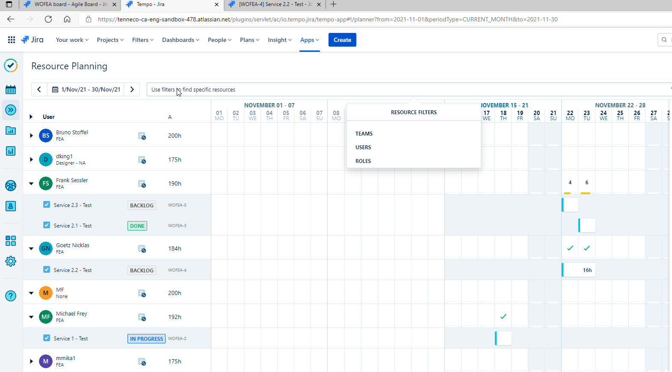
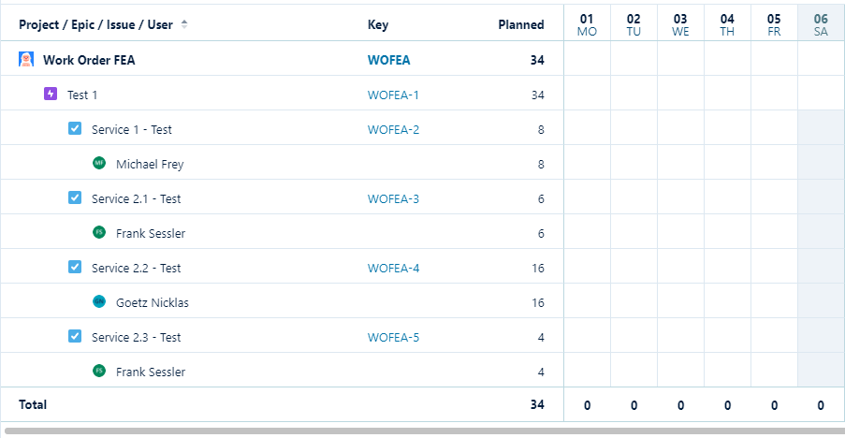
Tempo
Planning
Filter capabilites missing
Epic as input + Task + Sub Task required. Similar to Report. This makes planning much easier.
Today it is difficult to easily plan and provide feedback to requestor
View for all Tasks + Sub-Tasks for an Epic missing
Report needed to see overview about planning for all issues from an Epic
Not possible in on view to view and modify Planning of a whole Epic

Slide 2
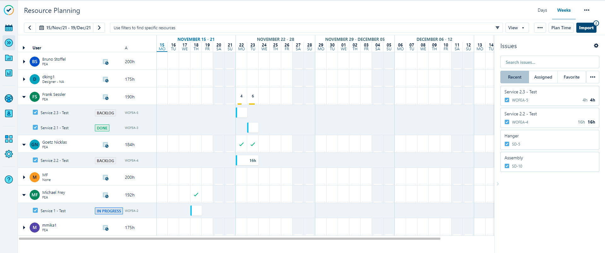
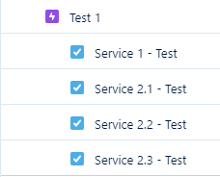
Tempo
Idea
In the Filter view it is possible to easily see all Tasks, Sub Tasks related to an Epic in the Issue dialog
See the planning of a whole Epic or multiple Epics in the planning view
Assign, modify planning
Choose Staff
Choose Epic: WOFEA-1, WOFEA- 6
Test 2

Slide 3
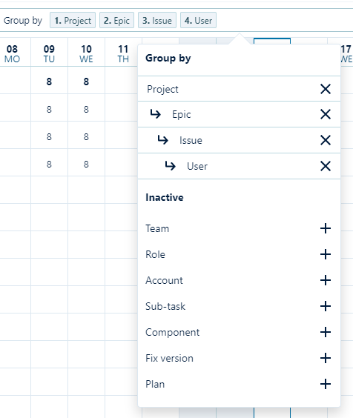
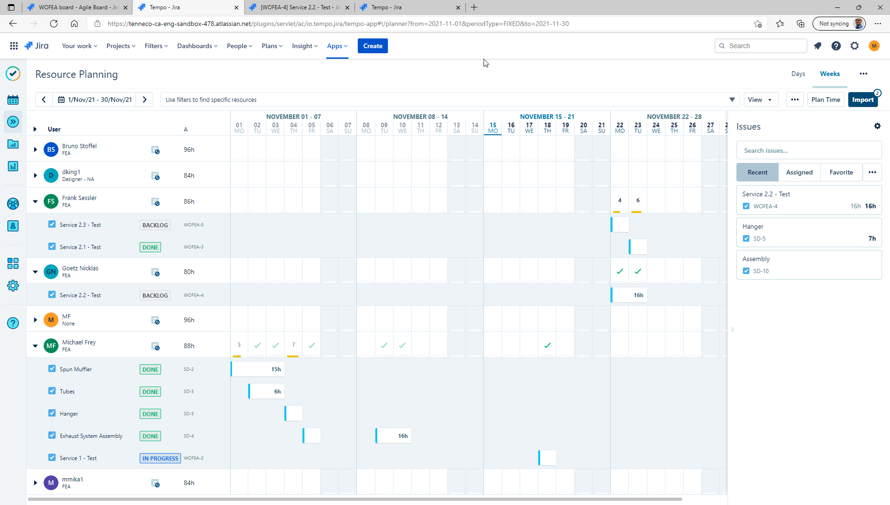
Tempo
Idea
Mix staff filter +with some elements of your „Group by“ Filter from Report
Filter Epic / Issues (multi input possible)
Filter Staff
Choose Epic: WOFEA-1
Show Epic + Task + Sub Tasks with Structure.
Option to only show Epic + Tasks + Sub Tasks related to chosen Epic
Other resources should be visible according to Filter Staff.

Slide 4
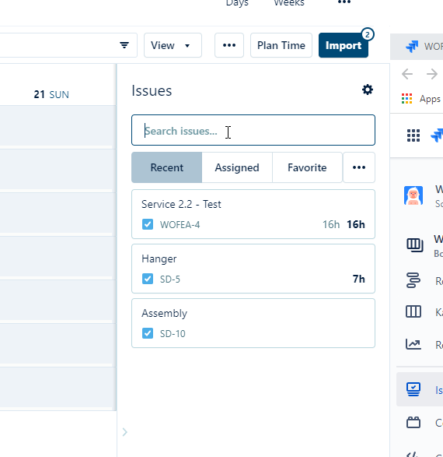
Tempo
Planner
Input: Search for Epic → all assigned Task + Sub-Tasks should be shown with its structure + estimated, remaining estimated, planned hours

